Slide 1
SCH4U Live Session
VSEPR Theory

Slide 2
Review
What is a chemical bond?

Slide 3
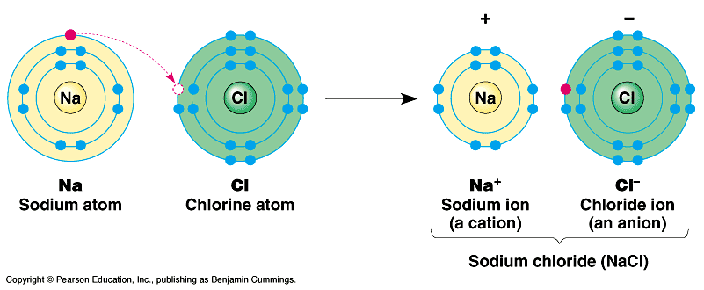
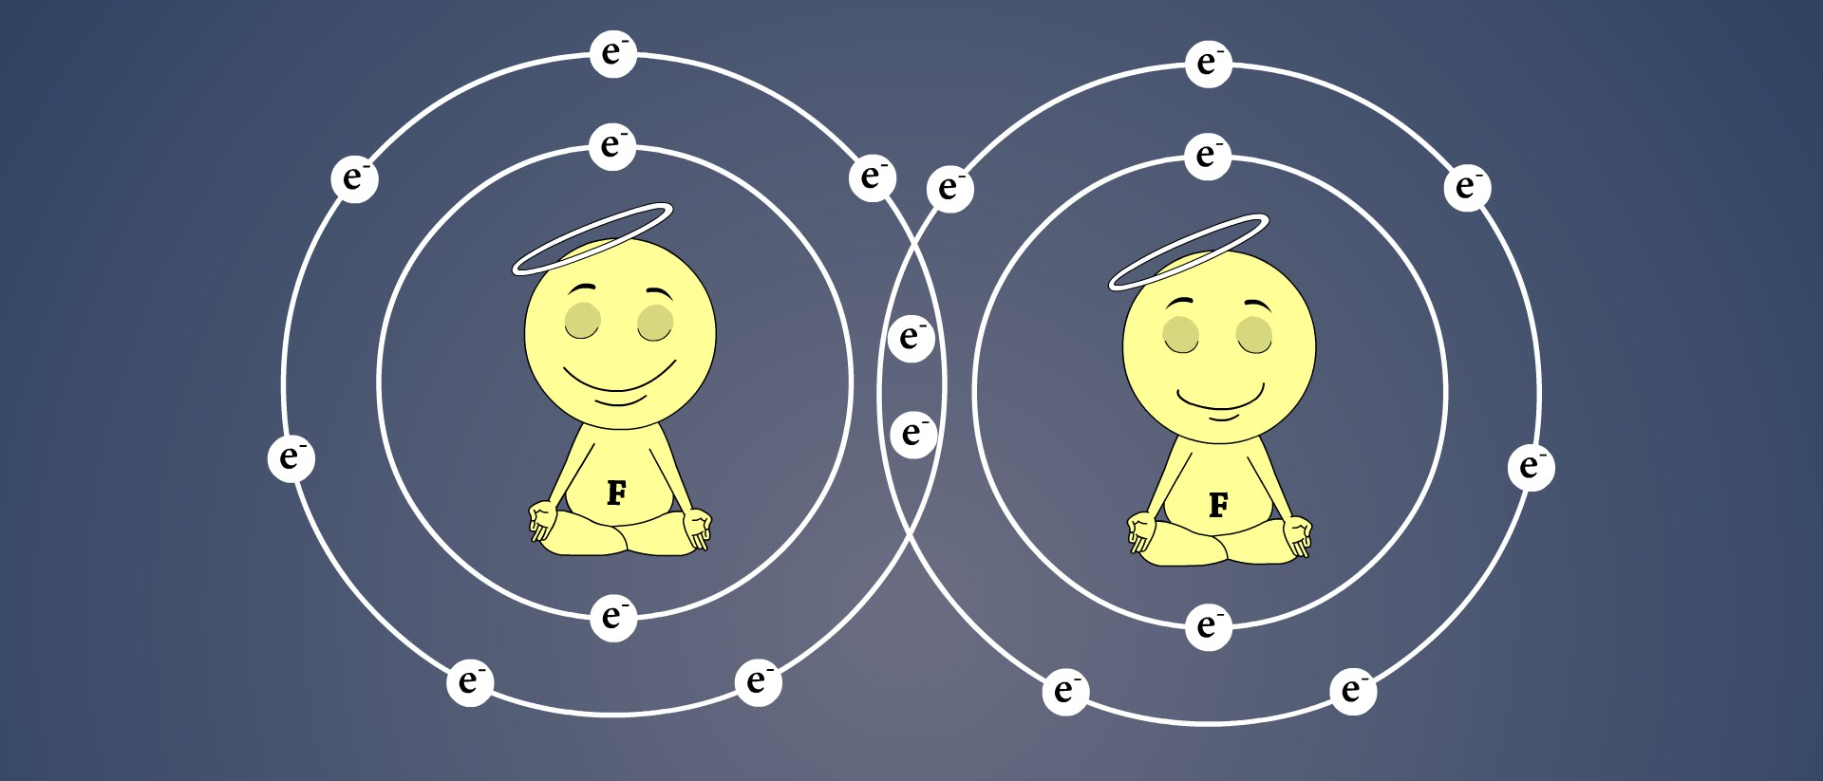
Review
What is a chemical bond?
A chemical bond is the electrical attraction that holds atoms together in a molecular element, molecular compound or ionic compound.

Slide 4
Review
Which of the following is a molecular element:
H₂O
CaO
N₂
CH₄
He

Slide 5
Review
Which of the following is an ionic compound?
H₂O
CaO
O₂
CH₄
He

Slide 6
Review
Which of the following is a molecular compound?
H₂O
CaO
O₂
CH₄
He

Slide 7
Review
Which of the following has a full valence shell?
Oxygen (O)
Carbon (C)
Hydrogen (H)
Neon (Ne)
Calcium (Ca)

Slide 8
Which of the following has the lowest bonding capacity?
Carbon (C)
Nitrogen (N)
Hydrogen (H)
Oxygen (O)
Fluorine (F)
Helium (He)

Slide 9
Valence Electrons

Slide 10
Review
Lewis theory of bonding:

Slide 11
Review
Lewis theory of bonding:
atoms are most stable when they have a full valence shell.
electrons tend to be in pairs.
atoms form chemical bonds to achieve a full valence shell.

Slide 12
Structural Formulas vs. Reality
What do compounds and polyatomic ions actually look like?
Does it matter what they look like?
What impact might the structure of a molecule have on its properties?

Slide 13
Structural Formulas
Draw the structural formula for CH₄

Slide 15
Structural Formulas

Slide 16
Structural Formula vs. Reality
The structural formula only represents the 2-D structure of the molecule.
Molecules and polyatomic ions actually occupy 3-D space, so the structural formula only tells part of the story about a molecule’s shape.

Slide 17
3-D Structure
The type of bonds in a substance (ionic, covalent, metallic) play a role in the properties of that substance such as hardness, boiling point, melting point, electrical conductivity.
The 3-D structure also has an impact on the properties of different substances:
  behaviour in chemical reactions
  interactions with other substances (enzymes)

Slide 18
3-D Structure – VSEPR Theory
How can we know the 3-D structure of molecules?
Technology does exist, NMR, X-ray crystallography, etc.
Expensive and time consuming.
To help understand the 3-D structure of molecules chemists developed a theory to predict these structures called VSEPR theory.
Pronounced VES-PER.

Slide 19
VSEPR Theory
VSEPR theory = Valence Shell Electron-pair Repulsion theory.
Main idea of the theory is that you can predict the shape of a molecule by organizing the atoms to reduce the repulsive force between electron pairs.
Like-charges repel each other.

Slide 20
VSEPR Theory – PHET Interactive
http://moodle.rosedaleacademy.com/mod/page/view.php?id=6178

Slide 21
VSEPR Theory
VSEPR theory – bonded and lone pair electrons position themselves as far apart as possible in a molecule to minimize the repulsive forces between them.
The angle between 2 bonds in a molecule is called the bond angle.
Electron-pair Repulsion.
Draw the structural formula for BeCl₂

Slide 23
Applying VSEPR Theory
1. Draw the simplified structural formula of the molecule.
2. Count the electron pairs surrounding the central atom including both bonded and lone pair electrons.
3. Arrange the surrounding atoms and any lone electron pairs around the central atom to minimize the repulsion between them by placing them as far apart as possible in a 3-D space.
4. Determine the name and bond angles of the structure from the positions of the atoms and the lone pairs of electrons.

Slide 24
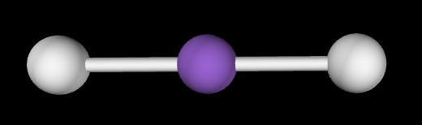
VSEPR Theory
Electron-pair repulsion
BeCl₂
Cl-Be-Cl
Ball-and-stick model

Slide 25
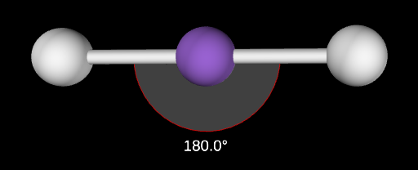
VSEPR Theory
Note there are 2 pairs of bonding electron pairs around the Be atom.
According to VSEPR theory these pairs of bonding electrons want to be as far apart from each other as possible.
When the bonding pairs are 180˚ apart the repulsion is minimized.
This angle is called the bond angle
This shape is called linear.

Slide 26
VSEPR Theory
BF₃ – structural formula (*Note in this molecule, boron does not have a stable octet*)

Slide 27
VSEPR Theory
BF₃ – Lewis structure
Does this arrangement minimize repulsion between bonding electron pairs?
(are the bonding pairs as far away from each other as possible?)

Slide 28
VSEPR Theory
If the bonding electron pairs are placed at 120˚ angles from each other the repulsions are minimized.

Slide 29
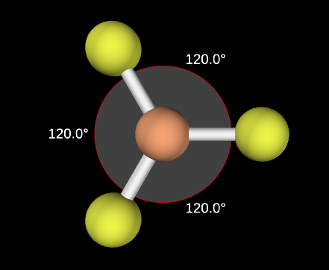
VSEPR Theory
If the bonding electron pairs are placed at 120˚ angles from each other the repulsions are minimized.
This shape is called trigonal planar.

Slide 30
VSEPR Theory
CH₄Lewis structure
Does this arrangement minimize repulsion between bonding electron pairs?
(are the bonding pairs as far away from each other as possible?)

Slide 31
VSEPR Theory
Does this arrangement minimize repulsion between bonding electron pairs?
Bond angles are all 90˚
However, using 3-D space the bond angles can be increased and the bonding pairs can be placed even further from each other.

Slide 32
VSEPR Theory
Using 3-D space the bond angles can be increased and the bonding pairs can be placed even further from each other.
This shape is known as tetrahedral.

Slide 33
VSEPR Theory
Rules for drawing 3-D VSEPR shapes:
Bond is in the plane of the paper
Bond extends backwards, into the paper or screen
Bond extends forwards, out of the paper or screen

Slide 34
Predict the structure of CCl₄ using VSEPR theory

Slide 35
Predict the structure of CCl₄ using VSEPR theory

Slide 36
VSEPR Theory – Lone Pairs
So far we’ve looked at how bonding electron pairs influence the 3-D shape of a molecule. What about lone pair electrons?
http://moodle.rosedaleacademy.com/mod/page/view.php?id=6178

Slide 37
VSEPR Theory – Lone Pairs
So far we’ve looked at how bonding electron pairs influence the 3-D shape of a molecule. What about lone pair electrons?
Only lone pair electrons on the central atom affect the 3-D shape of a molecule.
Lone electron pairs repel a little bit more than bonding pairs.
This pushes the bonding pairs of electrons closer together.
Draw the NH₃ structural formula

Slide 39
VSEPR Theory – Lone Pairs
So far we’ve looked at how bonding electron pairs influence the 3-D shape of a molecule. What about lone pair electrons?
Only lone pair electrons on the central atom affect the 3-D shape of a molecule.
Predict the 3-D shape of this molecule.

Slide 41
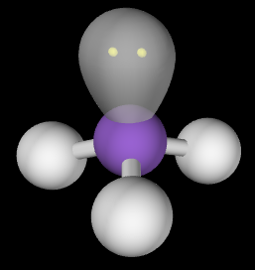
Lone electron pairs repel a little bit more than bonding pairs.
This pushes the bonding pairs of electrons closer together (109.5˚ → 107˚).
This shape is called trigonal pyramidal with bond angles of 107˚
107˚
107˚

Slide 42
VSEPR Shapes – Water (H₂O)
Draw the Lewis structure for H₂O

Slide 43
VSEPR Shapes – Water (H₂O)
Draw the Lewis structure and structural formula for H₂O
Ignoring lone pairs you may predict a linear structure (180 ˚ bond angles).
Lone pairs around the atom repel the bonding pairs, reducing the bond angles and changing the 3-D shape.

Slide 44
VSEPR Shapes – Water (H₂O)
Lone pairs around the atom repel the bonding pairs, reducing the bond angles and changing the 3-D shape.
This shape is called bent with bond angles of 104.5˚

Slide 45
Applying VSEPR Theory
1. Draw the simplified Lewis Structure of the molecule.
2. Count the electron pairs surrounding the central atom including both bonded and lone pair electrons.
3. Arrange the surrounding atoms and any lone electron pairs around the central atom to minimize the repulsion between them by placing them as far apart as possible in a 3-D space.
4. Determine the name and bond angles of the structure from the positions of the atoms and the lone pairs of electrons.

Slide 46
Predict the structure and bond angles of PH₃ using VSEPR theory.

Slide 47
Predict the structure and bond angles of PH₃ using VSEPR theory.

Slide 48
Predict the structure and bond angles of PH₃ using VSEPR theory.
Name: trigonal pyramidal
Bond angles: 107˚
• •

Slide 49
VSEPR Theory – Multiple Bonds
What shapes do molecules with double and triple bonds form?
Double and triple bonds are considered as one bond when applying VSEPR theory.
Consider CO₂

Slide 50
VSEPR Theory – Multiple Bonds
Each C-O bond is a double bond that has 2 pairs of electrons.
When applying VSEPR theory consider double and triple bonds as a single group of electrons.

Slide 51
VSEPR Theory – Multiple Bonds
Each C-O bond is a double bond that has 2 pairs of electrons.
When applying VSEPR theory consider double and triple bonds as a single group of electrons.
Shape: Linear
Bond angles: 180˚

Slide 52
Using the VSEPR Simulator
http://moodle.rosedaleacademy.com/mod/page/view.php?id=6178
Complete the table at the end of your handout by adding bonds and lone pairs of electrons.
Note: in the “Model” tab, not all bond angles are correct, consider the bond angles already included in the table the correct ones.

Slide 53
https://www.chem.purdue.edu/vsepr/practice.html
http://moodle.rosedaleacademy.com/mod/page/view.php?id=6177
https://www.chem.purdue.edu/vsepr/practice.html
VSEPR Simulator Link:
http://moodle.rosedaleacademy.com/mod/page/view.php?id=6178

