Slide 1
SCH4U Electronegativity & Polarity

Slide 2
Review
Atoms form chemical bonds with other molecules to obtain full valence shells.
2 types of chemical bonds: covalent & ionic
Covalent bond:
Ionic bond:

Slide 3
Review
Atoms form chemical bonds with other molecules to obtain full valence shells.
2 types of chemical bonds: covalent & ionic
Covalent bond: atoms share electrons
Ionic bond: electrons from one atom are transferred to another to form positive & negative ions.
Molecules form specific 3-D shapes, predicted by VSEPR.
VSEPR theory predicts that molecules will form shapes that minimize the repulsion of neighbouring electron pairs.

Slide 4
Review
Molecules form when atoms chemically bond to each other.
Molecules form specific 3-D shapes, predicted by VSEPR.
VSEPR theory predicts that molecules will form shapes that minimize the repulsion of neighbouring electron pairs.

Slide 5
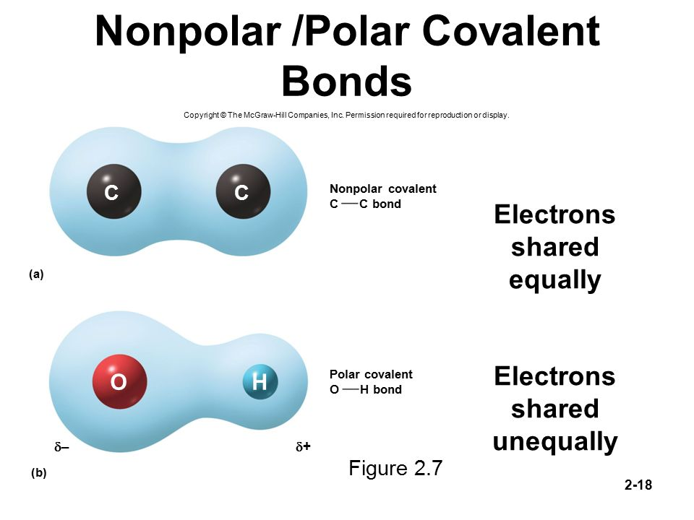
Covalent Bonds
In a covalent bond, the 2 atoms bonded to each other may share the electrons equally or unequally.
Non-polar covalent bond
Polar covalent bond

Slide 6
Non-polar Covalent Bonds
Non-polar covalent bonds usually form between 2 identical atoms as in molecular elements (O₂, N₂, C₂, etc.)

Slide 7
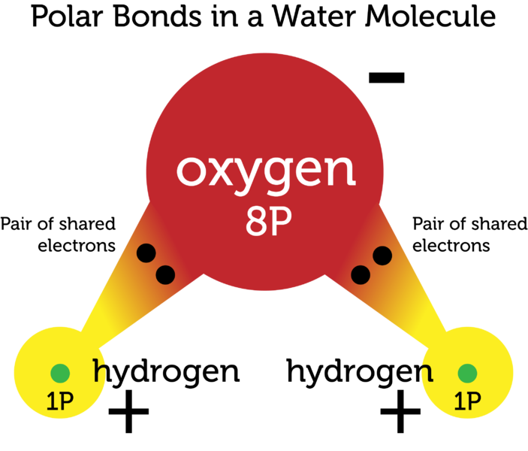
Polar Covalent Bonds
Polar covalent bonds form between atoms that attract the shared pair of electrons differently.
Oxygen has a higher affinity for electrons than hydrogen. When there is an O-H bond, oxygen will pull the shared electrons closer to itself.
This will create a partial negative charge towards the oxygen and a partial positive charge towards the hydrogen atom.

Slide 8
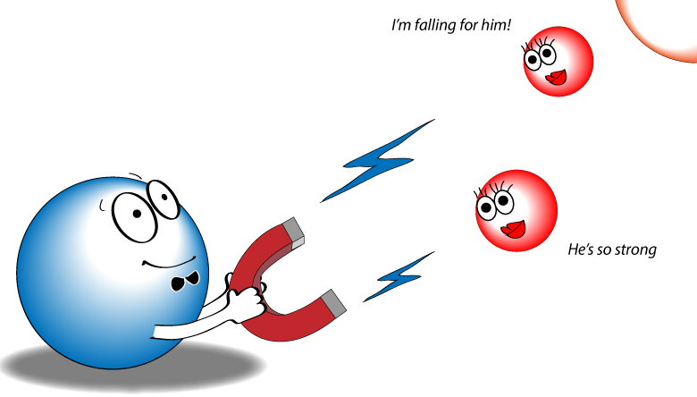
Electronegativity
The electronegativity of an atom is a measure of how strongly an atom attracts a pair of electrons it shares with another atom in a covalent bond.
Atoms with high electronegativity values tend to pull the shared electrons towards them.
Atoms with low electronegativity give up their shared electrons easily.

Slide 9
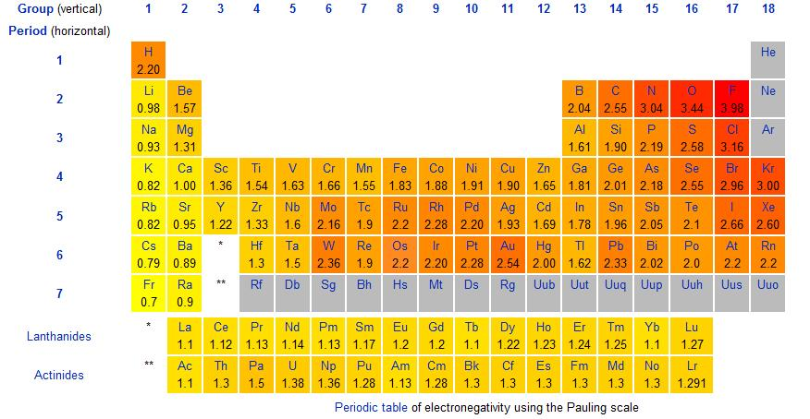
Electronegativity values
Increasing Electronegativity
Increasing Electronegativity

Slide 10
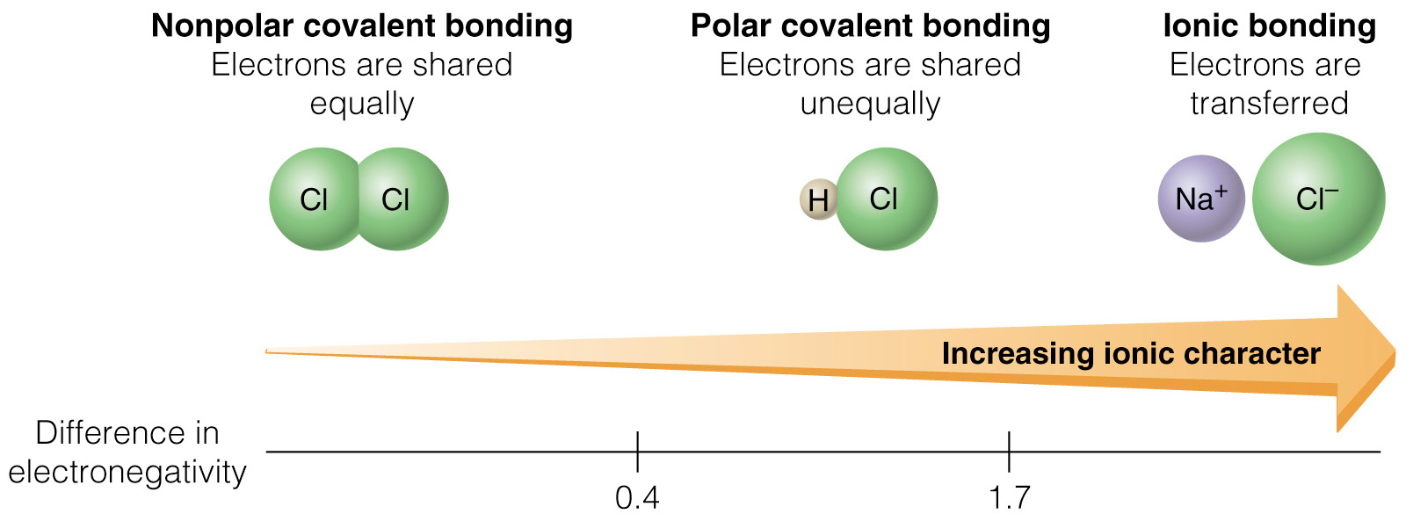
To determine the type of bond that forms between two atoms (ionic, polar covalent, non-polar covalent), you can calculate the difference in electronegativity (∆EN) between them.
Large ∆EN indicates polar covalent or ionic bonds.
Small ∆EN indicates non-polar covalent bonds.
∆EN | Bond type
< 0.5 | non-polar covalent
0.5-1.7 | polar covalent
>1.7 | ionic

Slide 11
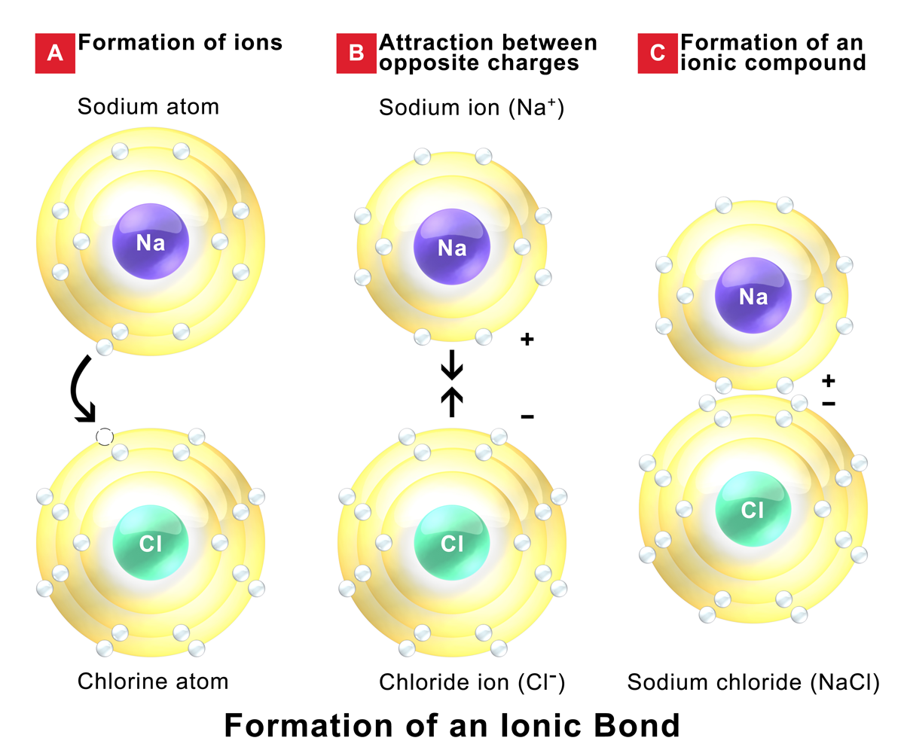
Ionic Bonds
Ionic bonds form when electrons are transferred from one atom to another creating a positive ion (cation) and a negative ion (anion).
Ionic bonds form when there is a large difference in electronegativity. (∆EN > 1.7)

Slide 12
Determine the ∆EN and classify the type of bond that forms between potassium and bromine (K-Br)

Slide 13
Determine the ∆EN and classify the type of bond that forms between potassium and bromine (K-Br)
∆EN_{K-Br} = EN_{Br} – EN_{K}
∆EN_{K-Br} = 2.96 - 0.82
∆EN_{K-Br} = 2.14
Since ∆EN > 1.7 this bond is an ionic bond.

Slide 14
Determine the ∆EN and classify the type of bond that forms between nitrogen and hydrogen (N-H)

Slide 15
Determine the ∆EN and classify the type of bond that forms between nitrogen and hydrogen (N-H)
∆EN_{N-H} = EN_{N} – EN_{H}
∆EN_{N-H} = 3.04 – 2.20
∆EN_{N-H} = 0.84
Since 0.5 < ∆EN > 1.7 this bond is polar covalent

Slide 16

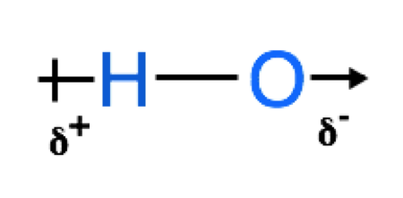
Bond Polarities - Dipoles
In bonds that have a polar character the more electronegative element becomes slightly negative and the atom with the lower electronegativity becomes slightly positive.
This separation of charge in space is called a dipole.
δ⁻ = negative end of a dipole
δ⁺ = positive end of a dipole
Arrow points towards the negative end.

Slide 17
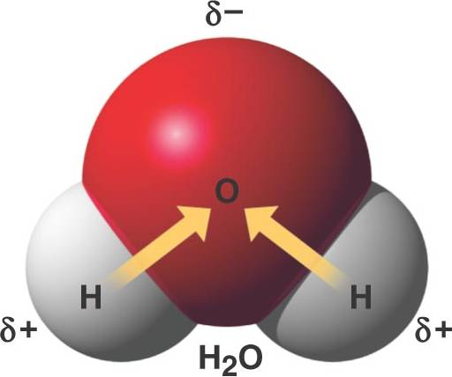
Molecular Polarity
Bonds can be polar or non-polar.
Entire molecules can also be either polar or non-polar.
The polarity of a molecule has a large effect on its properties.

Slide 18

Polar Molecules
Try this at home: charge a balloon by rubbing it on your head.
Turn on the tap.
Place the balloon close to the water stream.

Slide 19
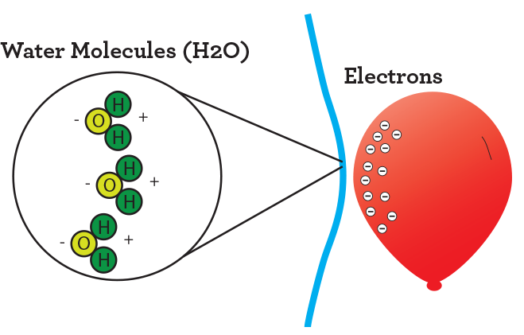
Polar Molecules
Static charge on the balloon is negative.
Positive dipoles in the water molecule are attracted to negatively charged balloon.

Slide 20
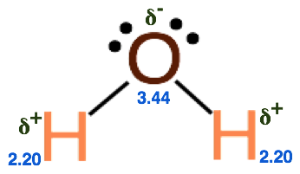
Polar Molecules - Water
Oxygen is more electronegative than hydrogen.
Bond dipoles form between each O-H bond.
The bond dipoles add together to the water molecule a net dipole.

Slide 21
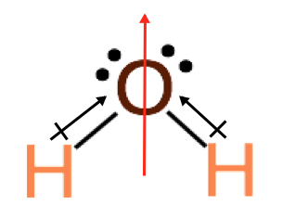
Polar Molecules – Water (H₂O)
Oxygen is more electronegative than hydrogen.
Bond dipoles form between each O-H bond.
The bond dipoles add together to the water molecule a net dipole.
Molecules with net dipoles are polar.
Net polarity of a molecule indicated with an arrow pointing towards the negative end of the molecule.

Slide 22
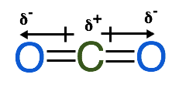
Non-polar molecules
Not all molecules with polar covalent bonds are polar.
A non-polar molecule has no net-dipole.
The arrangement of atoms in the molecule affects the polarity.
When the sum of the bond dipoles is zero, the molecule is non-polar.
When the polarities of bonds are equal in magnitude and opposite in direction the molecule is non-polar.

Slide 23
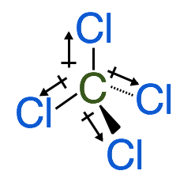
Non-polar molecules
The arrangement of atoms in the molecule affects the polarity.
When the sum of the bond dipoles is zero, the molecule is non-polar.
When the polarities of bonds are equal in magnitude and opposite in direction the molecule is non-polar.

Slide 24
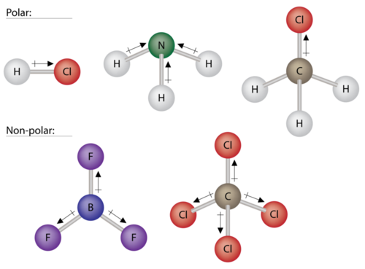
Predicting Polarity
To predict the polarity of a molecule you must consider:
types of bonds (polar or non-polar).
3-D shape of the object.

Slide 25
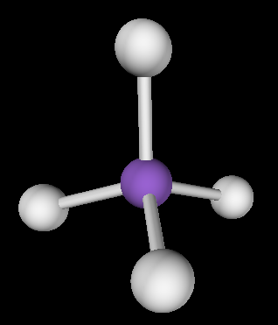
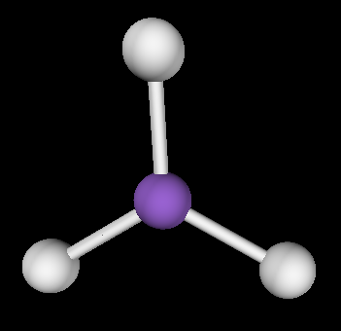
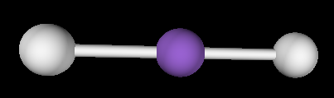
Polar Bonds no Net Dipole
Linear with 2 identical bonds (CO₂)
Trigonal Planar with 3 identical bonds (SO₃)
Tetrahedral with 4 identical bonds. (CCl₄)

Slide 26
Determining Net Polarity
Draw the Lewis structure.
Determine the predicted shape of the molecule using VSEPR.
Identify the electronegativity of each atom in the molecule and determine the partial charges in the molecule.
Draw bond dipoles and determine whether the molecule has a net dipole.

Slide 27
Predict the polarity of NH₃
Draw the Lewis structure.
Determine the predicted shape of the molecule using VSEPR.
Identify the electronegativity of each atom in the molecule and determine the partial charges in the molecule.
Draw bond dipoles and determine whether the molecule has a net dipole.

Slide 28
